Slide 1

Visual Studio Code

Slide 2
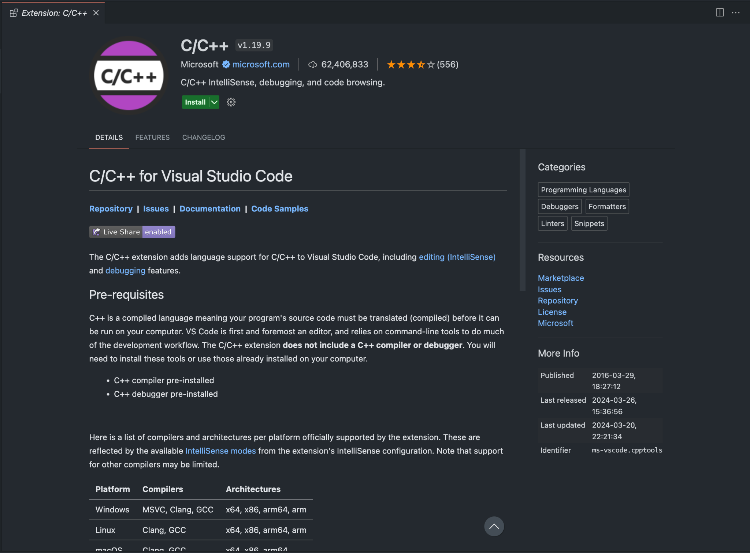
Setup Visual Studio Code
Install VS Code from:
https://code.visualstudio.com/
Install C/C++ extension from the VS Code Extensions library.

Slide 3
Run C++ Locally
Ensure g++ is installed with the following command:
g++ --version
To compile a file main.cpp, run:
g++ main.cpp
To run the executable produced a.out, run:
./a.out
Custom Executable
To compile a file main.cpp with a custom executable, run:
g++ main.cpp -o output
To run the executable produced output, run:
./output

Slide 4
Terminal Command Cheat Sheet
cd <directory>
Change directory to <directory>
*must be a child directory
cd ..
Change to the parent directory
pwd
print working (current) directory
ls
list files + directories inside of directory
mkdir <directory>
make directory called <directory>
control + c
abort running command
code .
open VS Code instance

